Slide 2
Learning objectives
In this lesson students will learn to:
Define what is meant by the 'stored program concept’
Describe the hardware components used in the von Neumann architecture and explain their role in the fetch-decode-execute cycle.
For more details on this topic and additional student activities see Topic 3 of the student book.
© Pearson Education Ltd 2020. Copying permitted for purchasing institution only.
Notes:
Specification content: 3.1.1

Slide 3
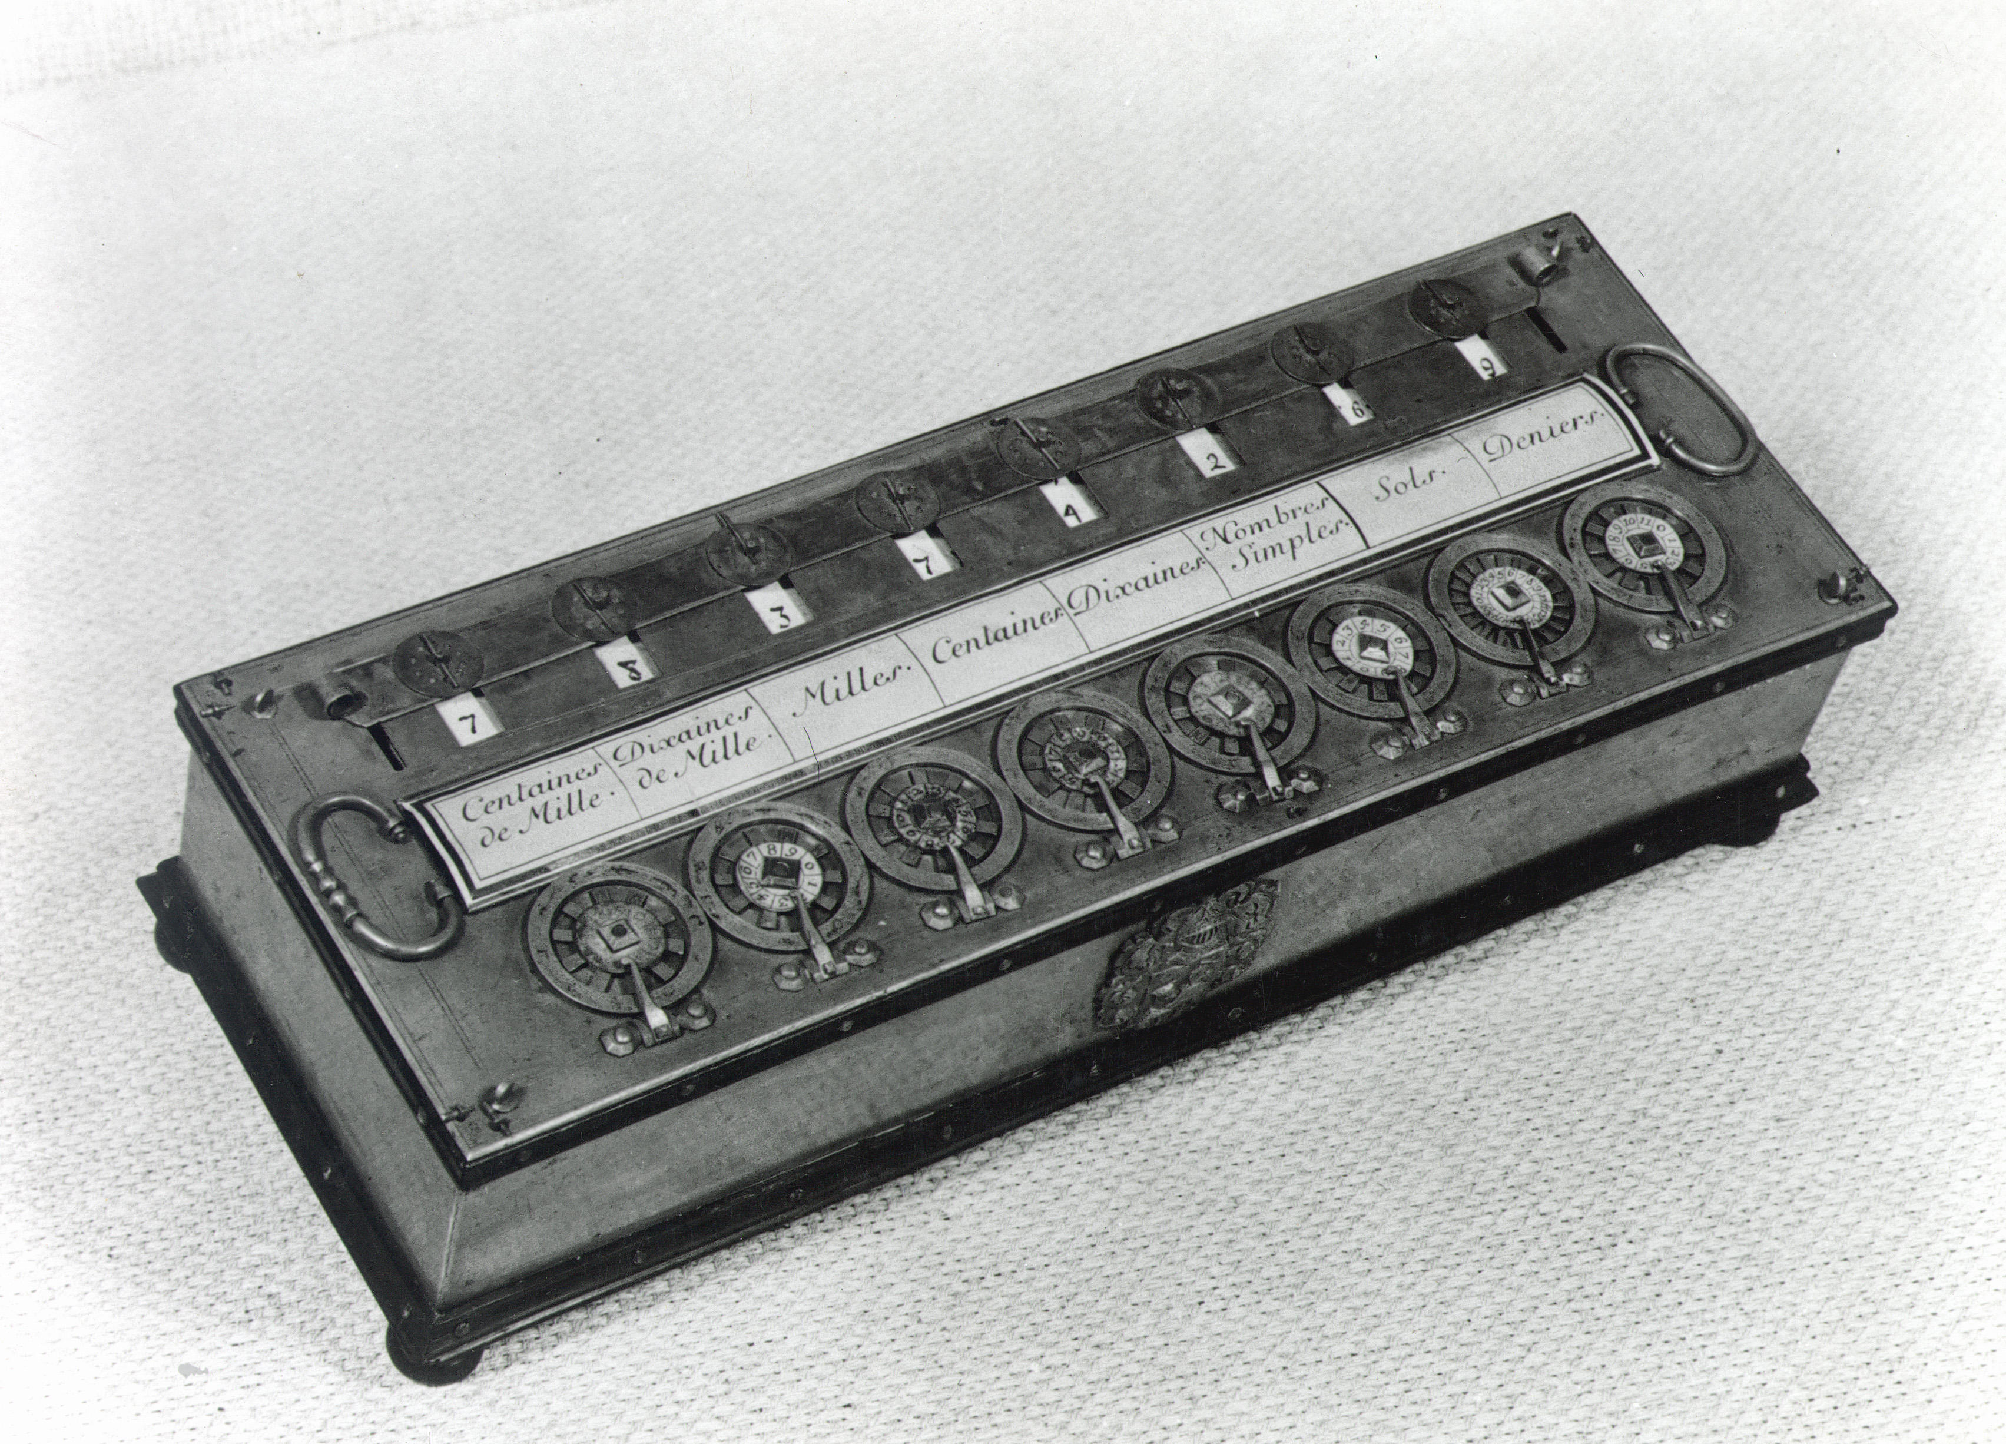
A little history
As long ago as the 1640s,
Mathematicians were creating
mechanical devices that could
perform mathematical operations.
They had hundreds or even
thousands of moving parts.
These devices were created to fulfil a single
purpose. If you wanted to change the purpose of such a device, it needed to be rebuilt or rewired.
Pascal’s calculator (shown here) was designed and built by the famous mathematician in 1642 (when he was 19 years old!) to help him with tax calculations. It performed multiplications and divisions.
© Pearson Education Ltd 2020. Copying permitted for purchasing institution only.

Slide 4
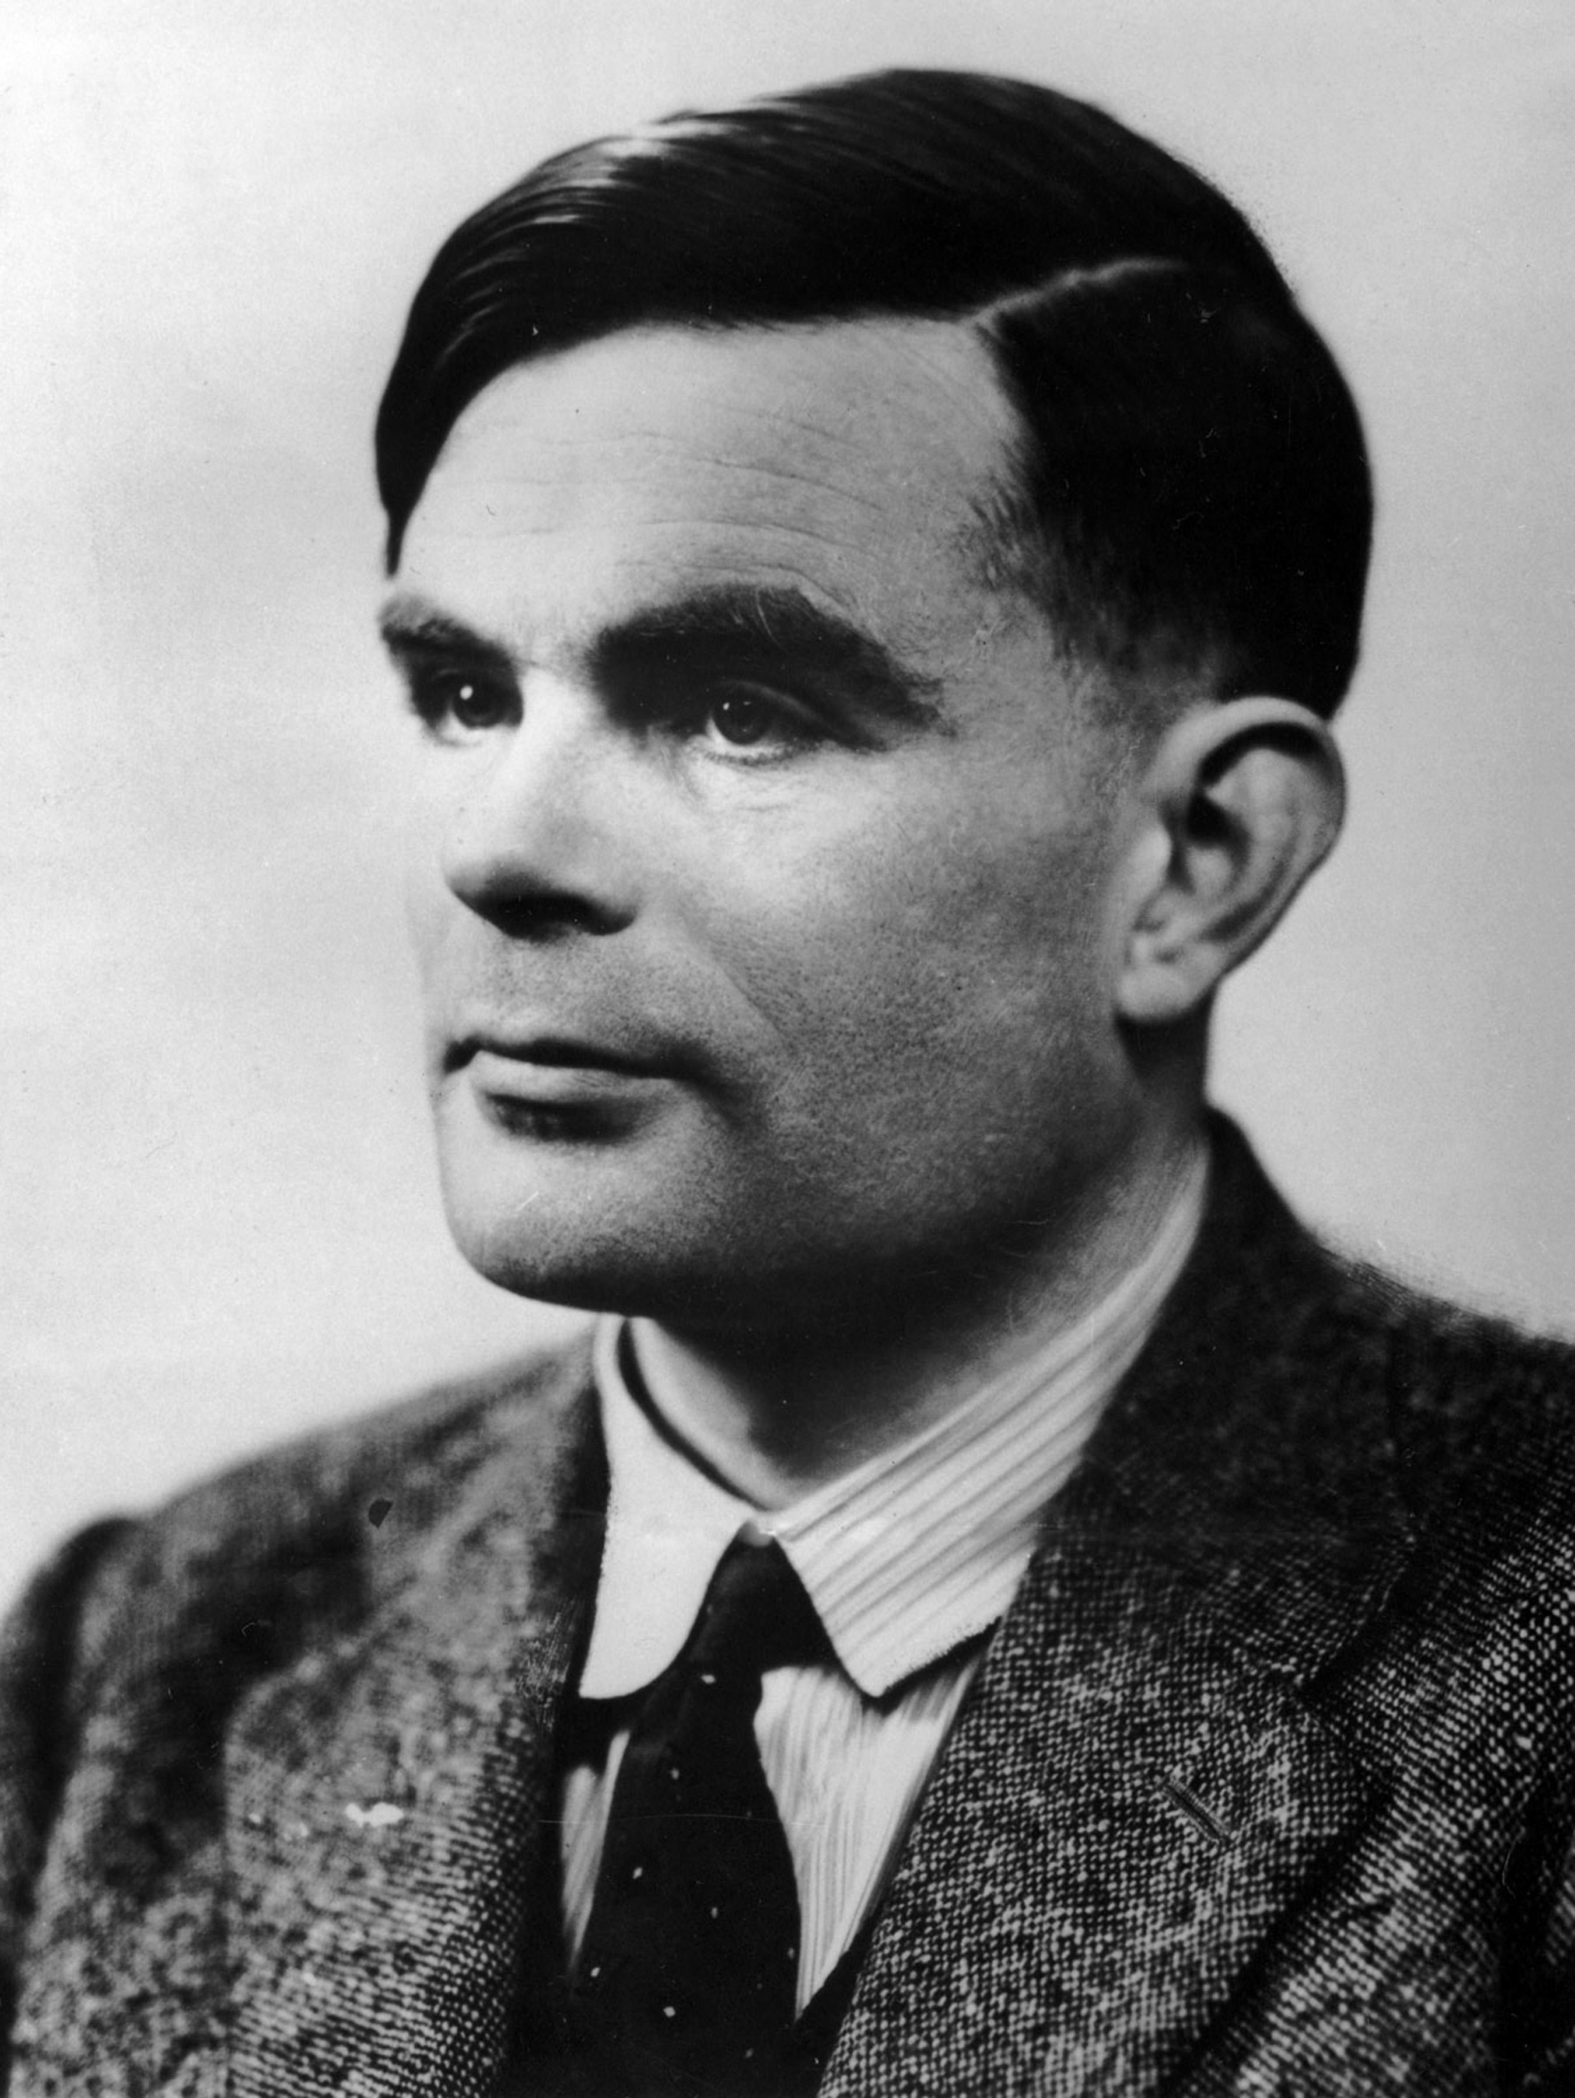
Programmable machines
In 1936, Alan Turing proposed a device he called the ‘Universal Computing Machine’.
He proposed that a computing machine could be designed that could be ‘programmed’ by giving it instructions on punched tape.
It was around this time that the work of engineer Tommy Flowers meant that computing devices were becoming electrical instead of mechanical machines.
© Pearson Education Ltd 2020. Copying permitted for purchasing institution only.
Notes:
https://student.craigndave.org/videos/gcse-edexcel-topic-3a-von-neumann-architecture

Slide 5
Stored programs
The next step was to move programs from tape and store them electronically within a computer.
In 1945, the mathematician and physicist John von Neumann, working at the University of Princeton USA, published a paper about the computer he and his team had designed and built.
It was the first computer that used the basic component architecture we recognise in modern computers.
© Pearson Education Ltd 2020. Copying permitted for purchasing institution only.

Slide 6
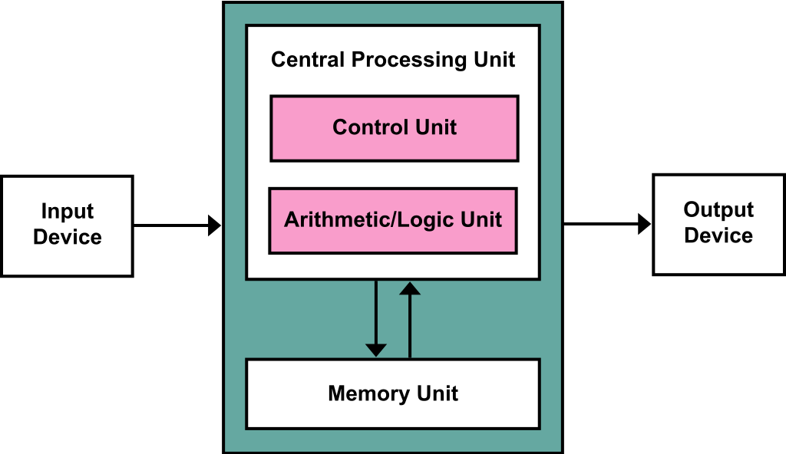
Von Neumann Architecture
Nearly every modern computer that exists today uses the structure pioneered by von Neumann. They are made up of the following components:
a processing unit that contains an arithmetic logic unit and processor registers
a control unit that contains an instruction register and program counter register
memory that stores both data
and instructions
external data storage
input and output mechanisms
© Pearson Education Ltd 2020. Copying permitted for purchasing institution only.
Notes:
Tutor: show after activity, for first 5 minutes only: https://student.craigndave.org/videos/gcse-edexcel-topic-3a-von-neumann-architecture
Student Activity 1

Slide 7
Fetch decode execute
The CPU follows three steps in order to process data.
The process is known as the fetch-decode-execute cycle (sometimes shortened to the fetch-execute cycle).
To begin with, whenever you open and work with a program, its data and instructions are loaded into your computer’s RAM.
As the RAM is accessed directly by the CPU, the CPU can get to work!
© Pearson Education Ltd 2020. Copying permitted for purchasing institution only.

Slide 8
Fetch
In this step, the CPU fetches data and instructions from the main memory (RAM) and then stores them in its own temporary, very fast memory called registers.
Can I have some data?
CPU
RAM / Memory
Yes! Here it is!
© Pearson Education Ltd 2020. Copying permitted for purchasing institution only.

Slide 9
Fetch
For this to happen, the CPU uses a hardware path called the address bus.
The memory address of the next item that the CPU wants is put onto the address bus.
Data from this memory address then travels from the RAM to the CPU on another hardware path called the data bus.
CPU
RAM / Memory
Address
Bus
CPU
Data
Bus
RAM / Memory
© Pearson Education Ltd 2020. Copying permitted for purchasing institution only.

Slide 10
Decode
The decode step involves the CPU working out what the instruction it has just fetched actually means.
The control unit decodes the instruction and gets things ready for the next step.
It does this by looking up the instruction from the instruction set. This is the full list of operations that a microprocessor can carry out.
© Pearson Education Ltd 2020. Copying permitted for purchasing institution only.

Slide 11
Execute
The execute stage is the point at which data processing happens.
Instructions are carried out on the data. Some instructions are carried out by the arithmetic logic unit (adding, shifting, AND, OR, etc.).
Once a cycle has completed, another begins.
© Pearson Education Ltd 2020. Copying permitted for purchasing institution only.

Slide 12
Fetch decode execute
Instructions and data are stored in the memory.
Instructions are fetched one at a time into the processor.
The instructions are decoded by the control unit.
The instructions are executed, sometimes using the arithmetic logic unit.
© Pearson Education Ltd 2020. Copying permitted for purchasing institution only.
Notes:
Student Activity 2

Slide 13
Wrap up: you have learned how to…
Define what is meant by the 'stored program concept’.
  Early computers had a single function and needed to be rewired or rebuilt for different functions.
  Programs stored inside the computer.
  All modern computers can be reprogrammed.
  Describe the hardware components used in the von Neumann architecture and explain their role in the fetch-decode-execute cycle.
  The memory holds the program’s instructions and data.
  The CPU contains the control unit and arithmetic logic unit used to carry out the instructions.
  The address bus holds the address in memory and the contents are passed along the data bus.
© Pearson Education Ltd 2020. Copying permitted for purchasing institution only.

